Slide 1
Ensemble Learning
Introduction to Machine Learning Exp 2
Spring 2019

Slide 2
Task
Implement some ensemble learning algorithms and test on a given dataset
Compare different ensemble learning algorithms with different base classifiers
Two ensemble learning algorithms: Bagging, AdaBoost.M1
Two base classifiers: SVM, Decision Tree
Thus, you should at least compare 4 combinations

Slide 3
Task (cont.)
You can use existing classifier, but the ensemble learning algorithms need to be implemented by yourself
Optional Tasks
Try other base classifier (such as K-NN, Naive Bayes...)
Analyze the effect of different (kinds of) features
Tune the parameters of ensemble learning algorithms, and analyse their effect on performance
Any other methods you'd like to get higher score

Slide 4
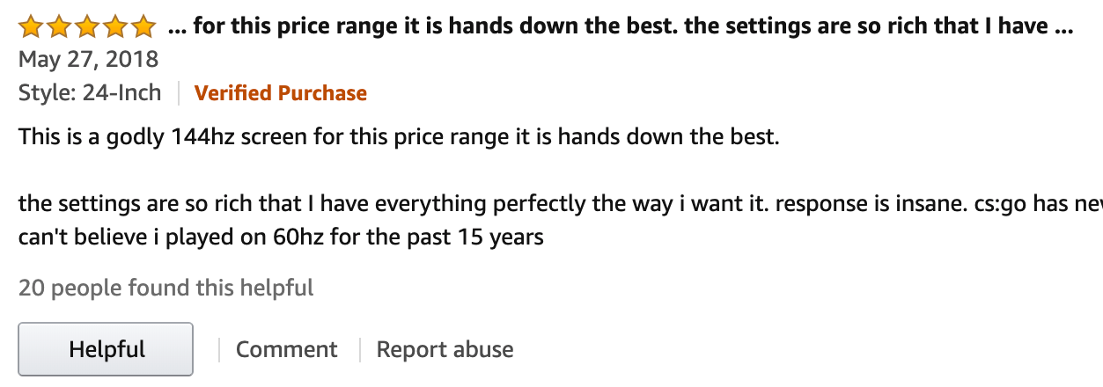
Dataset
Product review quality estimation
A key component for e-commerce, e.g. review ranking, recommendation, etc.
Review helpfulness prediction
Problem definition
each review r_i = {P, C, A, H}
P: Product & product rating, C: Content, A: Author/Reviewer,
H: Helpfulness
Given P, C, A, predict H
An exmaple of review in Amazon
A classification problem

Slide 5
Data Fields
Id: identify test cases (only appear in test set)
reviewerID: unique id of each reviwer
asin: unique id of each item
reviewText: content of review in English, without preprocessing
overall: the rating user gives to item (from 1 to 5)
votes_up: number of up votes to this review
votes_all: number of total votes to this review
label: 0 for low quality, and 1 for high quality

Slide 6
File Description
train.csv: training set
test.csv: test set , without information about votes and label
Additional
Reviews with votes_up / votes_all ≥ 0.9 ​are considered as high quality reviews. All the reviews are assured to have at least 5 votes_all
You should generate results on each reviews in test.csv, where reviewerID and asin are assured to have been appeared in train.csv

Slide 7
Evaluation
A inclass competition on Kaggle!
Three steps to come aboard:
Register an account on Kaggle
Visit competition invitation link
Join it!
Data file can be download there
Note: final rank on leaderboard will be taken into consideration, but don’t worry, just for a little reference

Slide 8
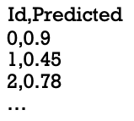
Evaluation (cont.)
Metric: AUC
Submission format: Id & Predicted (probability)
Header must be included
Id must match
Up to 3 submissions per day
Two benchmarks has been submitted
DTree: 0.56
Bagging+DTree: 0.66
There are private test set. Do not try to cheat the system

Slide 9
Submission
Source Code
With necessary comments
No restriction on programming languages, but make sure that TA can run your code easily
README
A text file that briefly describes how to run your code and produce the reported results.
Make sure your name, your student ID, your name on Kaggle and your contact information included.
Report (PDF)
Experimental design/results
Performance of different methods on Kaggle
Your analysis and discussion

Slide 10
Deadline
Deadline: 2019.05.16 Thursday 23:59
Upload the zipped file, with your name and student id in the filename, to learn.tsinghua.edu.cn
Late submissions WILL NOT BE ACCEPTED
Contact TA
Chenyang Wang
THUwangcy@gmail.com
17888802343

Slide 11
Toolkits
SVM
Sklearn: https://scikit-learn.org/stable/modules/svm.html
LibSVM: https://www.csie.ntu.edu.tw/~cjlin/libsvm/
SVM-light: http://svmlight.joachims.org/
Decision Tree
Sklearn: https://scikit-learn.org/stable/modules/tree.html
C4.5: http://www.rulequest.com/Personal/
C5.0: http://www.rulequest.com/see5-info.html
Please note that even if the package provides ensemble learning tools, you SHOULD NOT use them

